Slide 1
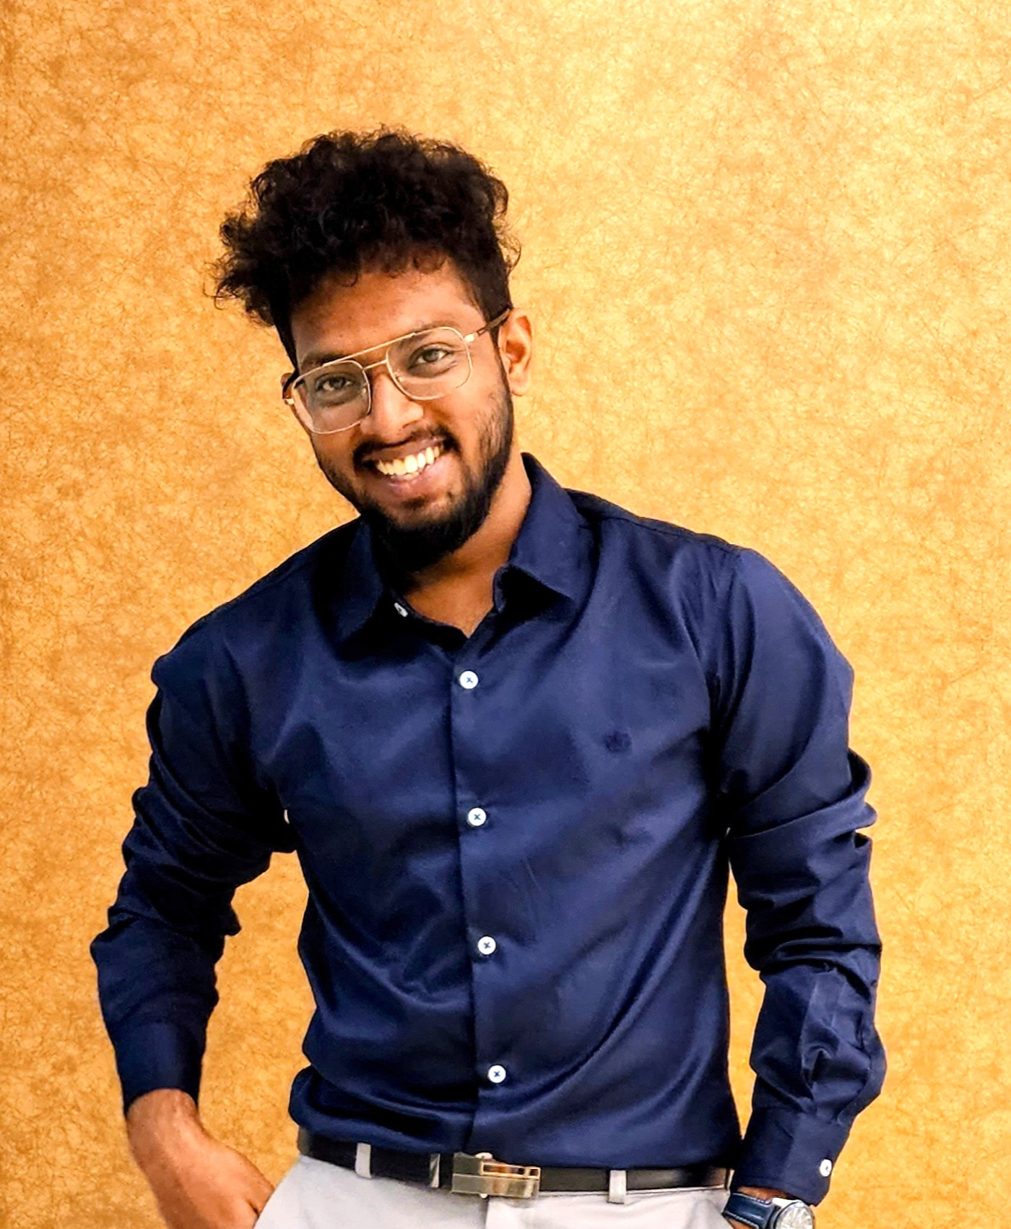
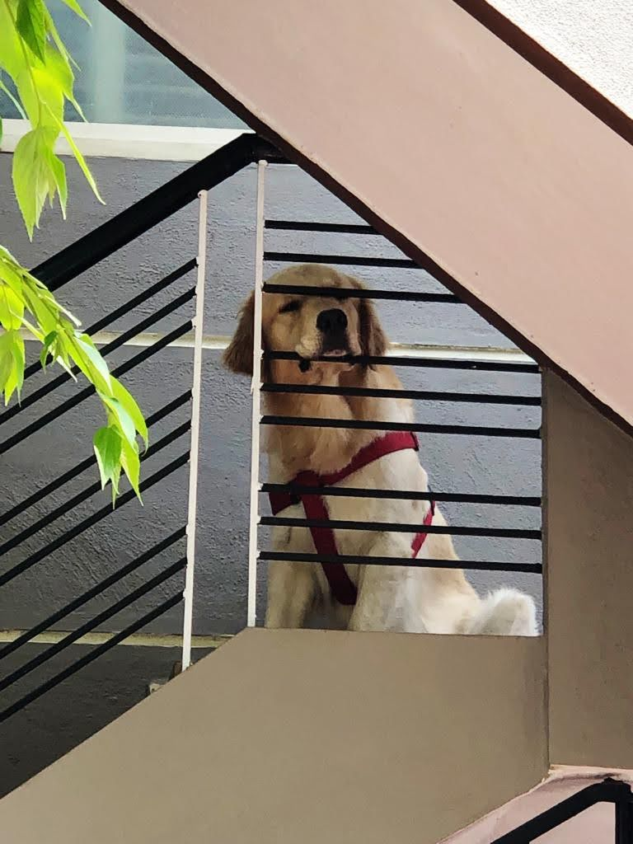

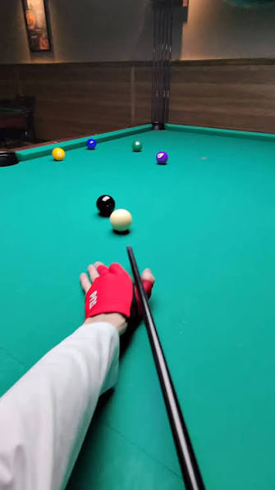
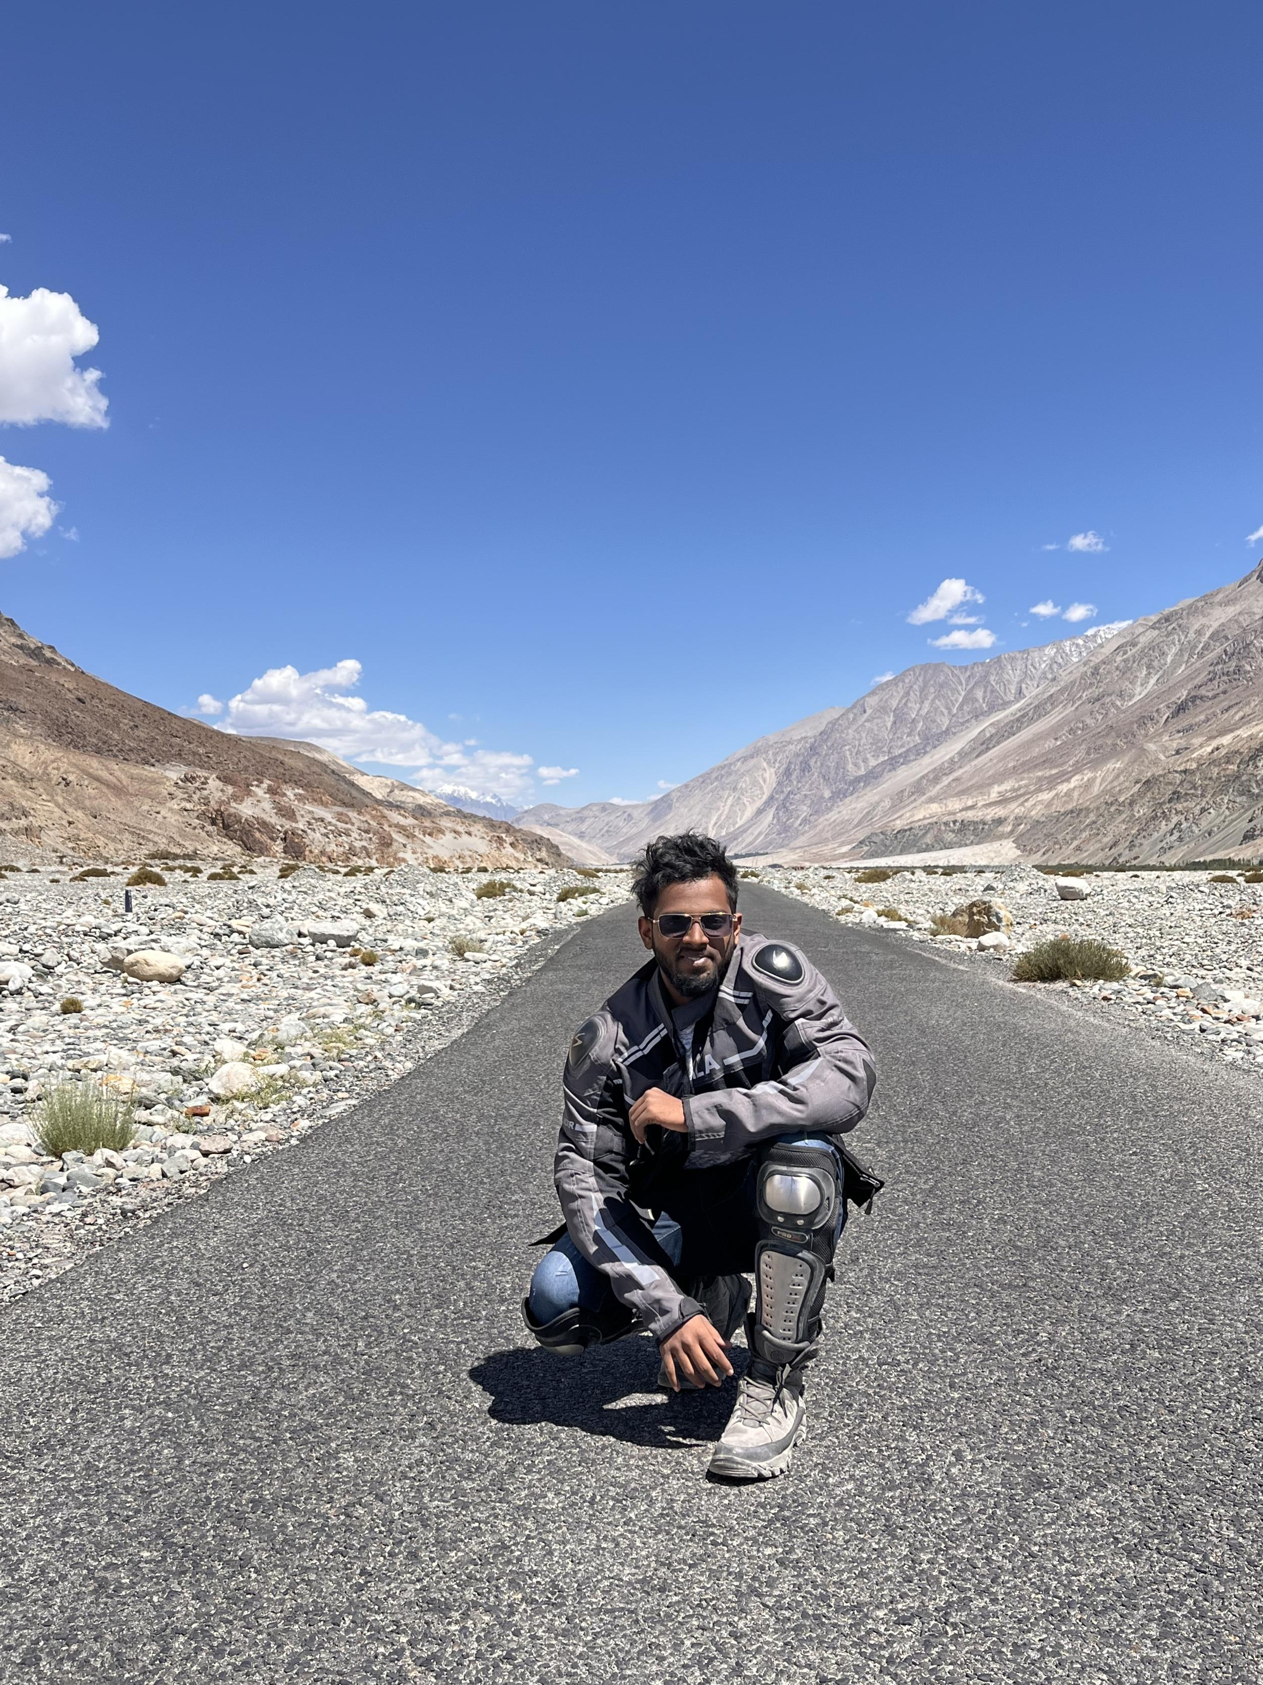
Ranjeeth B
Inside Specialist Engineer | Dell Technologies
6 Yrs 7 Months
CERTIFICATIONS & PUBLICATIONS
Associate – Information Storage & Management v4.0
Specialist – Technology Architect, Midrange Storage v2.0
Specialist – PowerStore Design
Specialist – Systems Administrator, VxRail
TECHNICAL EXPERTISE
PERFORMANCE & RECOGNITION
Products and Platform
111%
120%
110%
Block Storage
Unity XT, PowerStore, PowerMax, Compellent
Q1 FY27
Attainment
H2 FY26
Attainment
H1 FY26
Attainment
HCI
VxRail, XC Nodes, Dell Private Cloud
Platform
VMware, Nutanix AHV
$5M
$4.6M
ENABLEMENT FRAMEWORKS BUILT
FY26 Q4 : Revenue
FY27 Q1 : Rvenue
Whitespace Campaign
Proactive identification and engagement for accounts with no specialist SA aligned
DELL RECOGNITION AWARDS
Partner Enablement Program
2×
3×
3×
4×
13×
11×
Train & Enable partners to build their technical confidence
Technical Enablement Framework : Internal
Game
Changer
Extra-
ordinary
Delight
Cheers
Bravo
Applause
Repeatable enablement structure for new hires to make them field ready

Slide 2
Ranjeeth B
Inside Specialist Engineer | Dell Technologies
6 Yrs 7 Months
HOW I ENGAGE
WHAT I DELIVER FOR CUSTOMERS & PARTNERS
D
DISCOVER
Custom Demos
Technical Deep Dives
Requirements gathering · Asset & workload assessment · Environment mapping · Lead-in demos
Tailored to customer use case & workload
Architecture walkthroughs & solution reviews
Workload Analysis
Peer Solutioning
A
ANALYZE
App & infrastructure fit assessments
Collaborative design with expert validation
Workload-to-product fit analysis · Competitive landscape assessment · Business case framing
Competitive Intel
Tech & Roadmap
D
DESIGN
Positioning strategy against competitors
Product updates shared with stakeholders
Solution architecture · Proposal & quote creation · Sizing validation · BoM reviews
Partner Enablement
Internal Enablement
DEFEND
Training & tools to empower partners
Knowledge sessions to upskill internal teams
D
Technical deep dives · Closing demos · Solution presentation · Competitive handling
Solution Design
Consultative Convos
Modeling Optimal solution based on the requirement
Align technology with business outcomes
POST-SALES: Installation & Configuration · Customer Satisfaction Issue Resolution

